Slide 1
Technical Support (420-1N6-AB) File System
Fall 2023

Slide 2
Outline
File Format
Metadata
File system

Slide 3
File Format

Slide 4
File Format
Files are big chunks of related data.
Many types of files: text files, music files, photos and videos.
File format is the way the data is organized inside a file.
When saving a file, the OS or application uses an existing standard to organize the data.
Example of standard file formats: JPEG, MP4 and DOCX.
Programmer sometimes use their own way of saving data.
Non-standard format cannot be read except by applications that created them.

Slide 5
File Formats: Text Files
Known as TXT files and contain text.
Text files are presented in a file using list of numbers stored as binary.
Binary | 01001000 | 01100101 | 01101100 | 01101100 | 01101111 | 00100000 | 01010111 | 01101111 | 01110010 | 01101100 | 01100100
ASCI | H | e | l | l | o |  | W | o | r | l | d

Slide 6
File Metadata

Slide 7
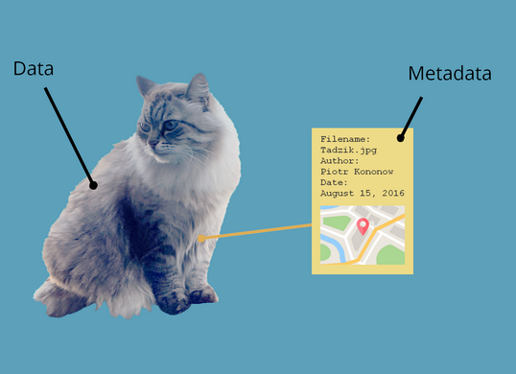
File Metadata
Many file formats cannot be stored so simply (a video file needs more structure than a text file, for example)
We need to include\save more data about the file to be able to read it properly. This data about the data is known as Metadata.
Metadata is data that provides information about other data.
File metadata provides information about the file data.
Stored at the front of the file data on the storage device. (ahead of the actual data).
Known as file header.

Slide 8
File Metadata: Example: Bitmap Photo (BMP)
B | M
 |  |  |  | File Size 4 bytes |  |  |  | Reserved |  |  |  | Offset |  |  |  | Header Size |  |  |  | Photo Width |  |  |  | Photo Height |  |  |  | Planes |  | Color Depth
Data
Metadata of BMP Photo
Source and details found at: https://en.wikipedia.org/wiki/BMP_file_format

Slide 9
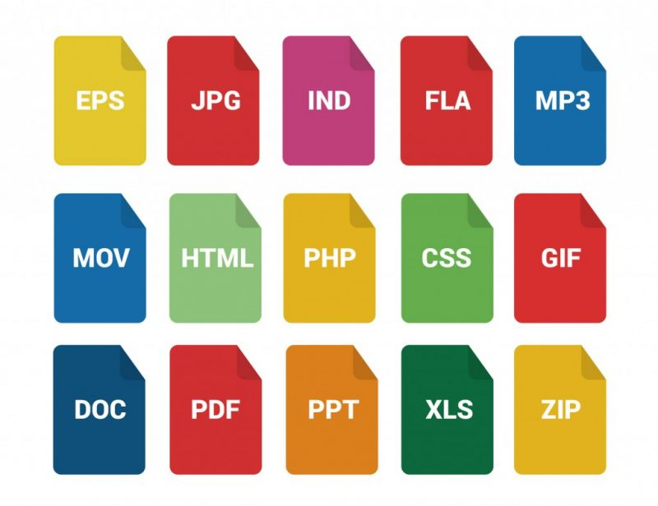
Files and File Formats
Under the hood, files are all the same:
Long lists of numbers, stored as binary, on a storage device.
Consist of two parts:
Metadata
Actual data.
File formats are the key to reading and understanding the data inside.

Slide 10
File Systems

Slide 11
Saving Files to Storage Devices
Computer store data on permanent storage technologies without having any power.
Hard drives, SSDs, magnetic tapes, flash drives.
Millions, billions and trillions of bits.
How are they organized?
File System:
Manages and keeps track of stored files on the disk.
Each OS has it own file system.

Slide 12
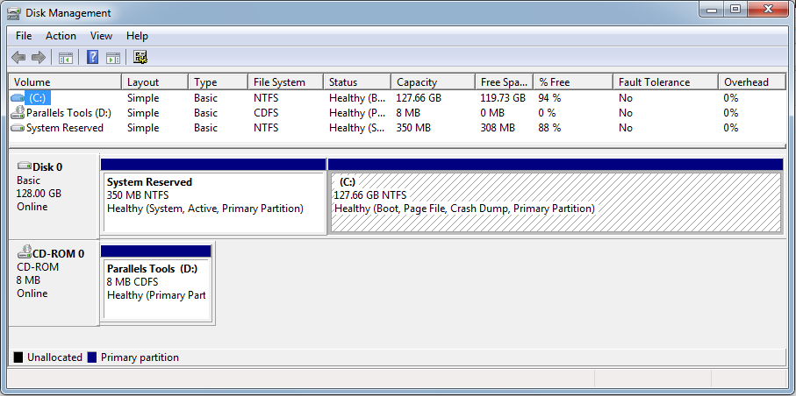
Partitioning
The process of subdividing the physical hard drive into smaller units each known as a partition.
A hard drive must have at least one partition.
Windows: Each partition is assigned a drive letter such as C: or D:

Slide 13
Partitioning Advantages
Partitions provide flexibility for hard drive organization.
Isolating OS files:
Keeping the OS, applications and data on the same partition is risky because if something happens to the partition's index file, you won't be able to boot up or even access the rest of the data on that partition.
If you keep your operating system and applications in a different partition to your data (documents, photos, music, etc.) the data will be easier to back up.
The OS partition can be formatted without affecting any data.
Partitioning allows users to install multiple OSs.
Each OS will be installed on a partition.

Slide 14
Formatting
Formatting is the process of creating a file system and making the root directory in that file system.
It organizes the partition so the OS can store files and folders on it.
Each partition on the disk must be formatted before it can hold data.

Slide 15
File System: Windows
NTFS (New Technology File System)
Support partition sizes up to 16 exabytes (in theory).
More file system security features and extended attributes than the FAT file system.
FAT32 (File Allocation Table 32-bit)
Support partition sizes up to 2 terabytes.
Limits data file size to 4 GB.
Used by Windows XP and older OS versions.

Slide 16
Data Migration
When a new installation is required, user data might need to be migrated from the old OS to the new one.
There are various tools available to transfer data and settings:
Windows User State Migration Tool (USMT)
Includes user accounts, user files, operating system settings, and application settings.
Cloud Solutions.
Physical Solutions:
External Drive.
Transfer cables.
Windows Easy Transfer
Old tool by Microsoft for transferring from Windows XP (32 bit) to Windows 7.

Slide 17
How does storage happen?
In the early days, when computers only performed one computation at a time, the storage operated like it was one big file.
Data started at the beginning of storage and then filled up in order as output was produced, up to the storage capacity.
 |  |  |  |  |  |  |  |  |  |  |  |  |  |  |  |  |  |  |  |  |  |  |  |  |  |  |  |  |  |  |  |  |  |  |  |  |  |  |  |  |  |  | …
 |  |  |  |  |  |  |  |  |  |  |  |  |  |  |  |  |  |  |  |  |  |  |  |  |  |  |  |  |  |  |  |  |  |  |  |  |  |  |  |  |  |  | …
 |  |  |  |  |  |  |  |  |  |  |  |  |  |  |  |  |  |  |  |  |  |  |  |  |  |  |  |  |  |  |  |  |  |  |  |  |  |  |  |  |  |  | …
 |  |  |  |  |  |  |  |  |  |  |  |  |  |  |  |  |  |  |  |  |  |  |  |  |  |  |  |  |  |  |  |  |  |  |  |  |  |  |  |  |  |  | …
 |  |  |  |  |  |  |  |  |  |  |  |  |  |  |  |  |  |  |  |  |  |  |  |  |  |  |  |  |  |  |  |  |  |  |  |  |  |  |  |  |  |  | …
 |  |  |  |  |  |  |  |  |  |  |  |  |  |  |  |  |  |  |  |  |  |  |  |  |  |  |  |  |  |  |  |  |  |  |  |  |  |  |  |  |  |  | …
 |  |  |  |  |  |  |  |  |  |  |  |  |  |  |  |  |  |  |  |  |  |  |  |  |  |  |  |  |  |  |  |  |  |  |  |  |  |  |  |  |  |  | …
 |  |  |  |  |  |  |  |  |  |  |  |  |  |  |  |  |  |  |  |  |  |  |  |  |  |  |  |  |  |  |  |  |  |  |  |  |  |  |  |  |  |  | …
 |  |  |  |  |  |  |  |  |  |  |  |  |  |  |  |  |  |  |  |  |  |  |  |  |  |  |  |  |  |  |  |  |  |  |  |  |  |  |  |  |  |  | …
01001000 01000101 01001100 01001100 0100111101001000 01000101 01001100 01001100 01001111…

Slide 18
Simple File System
As computational power and storage capacity advanced, more than one file was would be stored at the same time.
How would we store multiple files?
The simplest solution is to store files back-to-back.
But how would the computer know where files begin and end?
Storage devices do not have notion of files.
They are just a mechanism for storing data.
 |  |  |  |  |  |  |  |  |  |  |  |  |  |  |  |  |  |  |  |  |  |  |  |  |  |  |  |  |  |  |  |  |  |  |  |  |  |  |  |  |  |  | …
Directory File
Todo.txt
OS.exe
exam.docx
code.c
File 1 | File 2 | File 3 | File 4 | Free Space

Slide 19
Solution: Directory File
Directory File: is a special file that is added to the storage to allow the OS find the files on the disk.
Kept at location Zero (before any data).
Includes the names of all the files in storage.
 |  |  |  |  |  |  |  |  |  |  |  |  |  |  |  |  |  |  |  |  |  |  |  |  |  |  |  |  |  |  |  |  |  |  |  |  |  |  |  |  |  |  | …
Directory File
Todo.txt
OS.exe
exam.docx
code.c
Todo.txt | OS.exe | exam.docx | code.c | Free Space
File: Todo.txt
Filename: Todo
Extension: txt

Slide 20
Directory File
Directory File
Name | Created | Last Modified | Owner | Read/Write | Begin Address | Length
Todo.txt | 11:15 2/2/2017 | 10:14 9/26/2019 | Aref | r/w | 10 | 8
OS.exe | 14:15 12/1/2015 | 14:15 12/1/2015 | admin | r | 18 | 30
exam.docx | 22:14 9/20/2019 | 10:30 9/26/2019 | Gabriel | r/w | 38 | 12
code.c | 10:14 8/26/2019 | 14:14 9/14/2019 | Youmna | r/w | 50 | 5
Stores metadata about the files as well.
If a file is added, removed or filename is changed, the information in the Directory File needs to be updated.

Slide 21
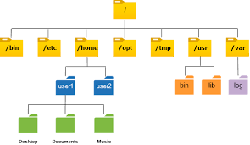
Hierarchical File system
Let’s make things more complicated and add directories within directories.
How should the directory file handle this?
Directory File
Name | Directory | Created | Last Modified | Owner | Read/Write | Begin Address | Length
Todo.txt | No | 11:15 2/2/2017 | 10:14 9/26/2019 | Aref | r/w | 10 | 8
Practice exams | YES | 3:30 10/10/2022 | 12:43 11/07/2023 | Youmna | r/w | 64
OS.exe | No | 14:15 12/1/2015 | 14:15 12/1/2015 | admin | r | 18 | 30
exam.docx | No | 22:14 9/20/2019 | 10:30 9/26/2019 | Gabriel | r/w | 38 | 12
code.c | No | 10:14 8/26/2019 | 14:14 9/14/2019 | Youmna | r/w | 50 | 5

Slide 22
Activity: Manipulate files using cmd
1. Open command prompt (cmd)
2. Navigate to the desktop
3. Create a directory called meals
4. Create a file called breakfast
5. Write the line coffee inside the file
6. Write the line toasts
7. Open the file
cd desktop
mkdir meals
Type nul > meals.txt echo coffee > breakfast.txt
…

Slide 23
Activity: How to view raw data in hexadecimal?
Powershell: format-hex file.exe

Slide 24
Main Issue with the Simple File System
Stacking files together, back-to-back, is not a proper solution for storing data.
Files will grow in size (more data added to them).
Growing files will overwrite other files’ data.
Example: If data was added to “todo.txt”, there is no room to do it without overwriting part of “OS.exe”.
Directory File
Todo.txt
OS.exe
exam.docx
code.c
Todo.txt | OS.exe

Slide 25
Modern File Systems
To resolve the issue of over writing data of other files, modern operating systems will:
Store Data in fixed size Blocks.
Provides extra space for the file to grow in size. Extra space is known as Slack Space.
All file data have the same common size simplifying management.
A file may occupy more than one block if needed or as it grows.
Block 0 |  |  |  |  |  |  |  |  |  | Block 1 |  |  |  |  |  |  |  |  |  | Block 2 |  |  |  |  |  |  |  |  |  | Block 3 |  |  |  |  |  |  |  |  |  | Block 4
 |  |  |  |  |  |  |  |  |  |  |  |  |  |  |  |  |  |  |  |  |  |  |  |  |  |  |  |  |  |  |  |  |  |  |  |  |  |  |  |  |  |  |  |  |  |  |  |  | …
Directory File |  |  |  |  |  |  |  |  |  | Todo.txt |  |  |  |  |  |  |  |  |  | OS.exe |  |  |  |  |  |  |  |  |  | Exam.docx |  |  |  |  |  |  |  |  |  | Free Space
Slack Space
Slack Space
Slack Space
Slack Space

Slide 26
Modern File Systems
Block 0 |  |  |  |  |  |  |  |  |  | Block 1 |  |  |  |  |  |  |  |  |  | Block 2 |  |  |  |  |  |  |  |  |  | Block 3 |  |  |  |  |  |  |  |  |  | Block 4
 |  |  |  |  |  |  |  |  |  |  |  |  |  |  |  |  |  |  |  |  |  |  |  |  |  |  |  |  |  |  |  |  |  |  |  |  |  |  |  |  |  |  |  |  |  |  |  |  | …
Directory File |  |  |  |  |  |  |  |  |  | Todo.txt |  |  |  |  |  |  |  |  |  | OS.exe |  |  |  |  |  |  |  |  |  | Exam.docx |  |  |  |  |  |  |  |  |  | Free Space
Name | Created | Last Modified | Owner | Read/Write | Blocks
Todo.txt | 11:15 2/2/2017 | 10:14 9/26/2019 | Michael | r/w | 1
OS.exe | 14:15 12/1/2015 | 14:15 12/1/2015 | admin | r | 2, 9, 5
exam.docx | 22:14 9/20/2019 | 10:30 9/26/2019 | Gabriel | r/w | 3
code.c | 10:14 8/26/2021 | 14:14 9/14/2021 | Michael | r/w | 10
Directory File will keep track of each block occupied by a file.

Slide 27
Modern File System and Blocks
Using blocks
Allow files to be broken into chunks and stored across many blocks.
Files can easily grow or shrink in size.
Grow 🡪 need more space 🡪 Allocated a new free block.
Shrink 🡪 space not needed 🡪 Deallocate reserved block.
File can grow to occupy as many blocks as needed.
Blocks might not be located next to each other or even in order.
File being broken across storage is known as Fragmentation.
This a result of files being created, deleted and modified.

Slide 28
Fragmentation
Fragmentation will increase the time to access the file.
Specially with storage device that require mechanical parts to move like HDDs.
Large files might be stored across hundreds of blocks and would require longer time to access.

Slide 29
Solution to Fragmentation
Defragmentation: reallocate data blocks so each file has its blocks located together in storage and in the right order.
Newer file systems are designed to minimize the need for defragmentation.
Blocks have a large buffer size ---> more slack space ---> less need for more blocks
Scatter files all over the disk 🡪 providing files with enough space to expand.
Running the defragmentation process in the background.
Additionally, newer storage hardware makes defragmentation less and less useful
Newer HDDs are much faster and more parallelized in their ability to read fragmented data
SSDs see no read/write improvement from defragmentation, since memory is not physically separated in a meaningful sense (in fact, the defragmentation process only wears the SSD down without any gains -- not recommended!)

Slide 30
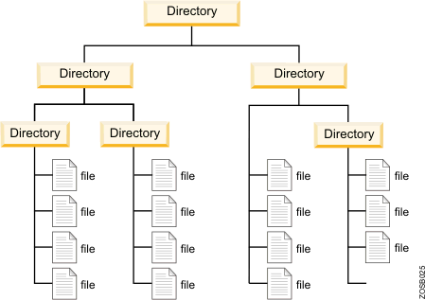
Flat File System Vs Hierarchical File System
Flat File System
All data save one level.
Similar to the examples we have seen.
There is no notion of directories.
Hierarchical File System
Allows to store related files in directories.
Also known as folders.
Directories can be nested in other directories.
Extra metadata is need to keep track what is a file and what is a directory.
Top Directory File is known as Root Directory.

Slide 31
Deleting Files
How does deleting file data work?
The user experience varies from operating system to operating system, but the overall behavior is the same
In all operating systems, it is possible to designate a Recycling Bin directory on the system, where the default delete command simply moves a file to the Recycling Bin directory.
Recycling Bin directories are no different than other directories -- files can be recovered from the Recycling Bin by simply moving them out
How to delete a file permanently?

Slide 32
Deleting Files
How does deleting file data work?
“Empty the recycle bin” -- yes, but how does that work? Move the file to Recycling Bin 2?
Think about how data is represented in a computer, about the data blocks we were just learning about. What would it mean for that data to be deleted?

Slide 33
Deleting Files
Answer:
Remove the file from its directory file. The operating system will no longer “know” about the file (no way to reference it) and its bits will be considered free space
Does this mean the data is deleted?

Slide 34
Deleting Files
Answer Pt 2:
Data that has been deleted in this manner can still be recovered!
This can be very difficult: it is an open field of research to optimise various data recovery programs for various applications
In principle:
view all the bits in free space. Recover this data directly
The problem?
The longer bits are in “free space”, the more likely they will be overwritten by a new file/block
Data can eventually become unrecoverable in its original form

Slide 35
Topics for further research
How to view and understand file metadata
Difference between deleting, recycling, and wiping your data on different operating systems
Understand how file recovery works
Notes:
cool example of data corruption: https://slate.com/culture/2013/01/melanie-willhide-to-adrian-rodriguez-with-love-photos.html http://www.vonlintel.com/Melanie-Willhide.html viewing file data directly in Windows: https://superuser.com/a/1247756
basic GUI kind of tutorial https://www.digitalcitizen.life/what-file-s-metadata-and-how-edit-it/
general overview of deletion: https://www.reddit.com/r/NoStupidQuestions/comments/37gzsi/when_i_permanently_delete_a_file_on_my_computer/
my recommended Windows tool:
https://docs.microsoft.com/en-us/windows-server/administration/windows-commands/cipher
https://www.majorgeeks.com/content/page/how_to_securely_delete_files_in_windows_10.html
the way a sane operating system handles this problem:
https://linuxhandbook.com/dd-command/

Slide 36
Q & A
Notes:
In Slide Show mode, click the arrow to enter the PowerPoint Getting Started Center.

